Slide 1
Working with Custom code in Talend
February 15, 2018
Presenter :

Slide 2
Working with Custom code in Talend
Creating Custom Routines/functions.
Example of Custom Routines.
Importing external jars and their functions.

Slide 3
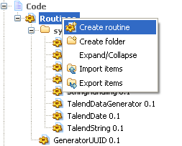
Creating Custom Routines/Functions
You can create your own routines according to your particular needs. Like the system routines, the user routines are stored in the Repository tree view under Code > Routines. You can add folders to help organize your routines and call them easily in any of your Jobs.
import java.text.SimpleDateFormat;
import java.util.Date;
public class string_to_date
{
public static Date convert2Date(String string_date,String date_format) throws Exception
{
SimpleDateFormat sdf = new SimpleDateFormat(date_format);
Date transformed_date = sdf.parse(string_date);
return transformed_date;
}
}

Slide 4
Importing external jars and their functions.
Talend has rich set of functions and libraries available with in its suite. However, you may want to use libraries provided by data vendor or API vendor e.g. if you want to fetch data from Google Ad words then you may want to include or import the library/jar files provided by Google into Talend.
There are two ways to include or import these external jar and library files.
1. Using tLibraryLoad component.
2. By editing the Routine library.

Slide 5
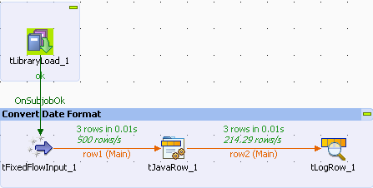
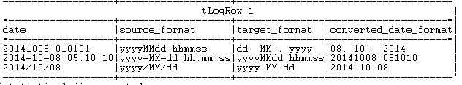
Importing external jars and their functions.
Using tLibraryLoad Component: It allows you to import and load useable Java libraries in a Job.
This method is used when you only want to use the library in a single Talend Job. As the library or external jar file imported using tLibraryLoad component will be available to only that Talend Job only.
Hence, if you want to use the library or external jar for the other Jobs as well then importing it by editing the Routine library is preferable.

Slide 6
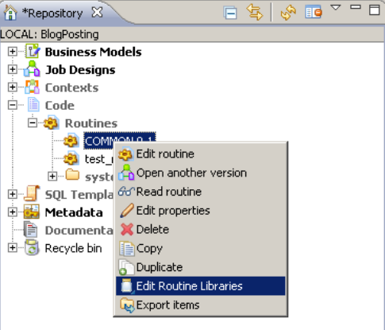
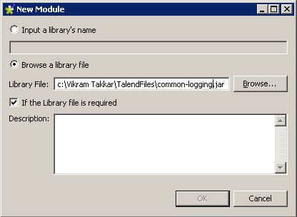
Importing external jars and their functions.
Edit Routine Library –
If you want to use the library or external jar
for the other Jobs as well then importing it
by editing the Routine library is preferable
1
2

Slide 7
Questions?
Copyright © 2014 by Vikram Takkar. All Rights Reserved..

